Slide 1
Fitting multilevel models using STEPS data from multiple countries for estimating health outcomes
Tim Raxworthy & Yajuan Si
Program in Survey & Data Science
The University of Michigan

Slide 2
What is HPACC and STEPS ?
Global Health and Population Project on Access to Care for Cardiometabolic Diseases (HPACC).
Collaborative research project between physicians, economists and public health researchers.
The HPACC core data set contains harmonized cross sectional survey data from over 100 countries.
The survey data are primarily collected from STEPS.
STEPS is the World Health Organization’s STEPwise approach to non communicable disease risk factor surveillance.
Conducted in three “steps” or phases: individual questionnaire, nurse exam, and further biomarker collection.
Designed to be representative of a finite country population (includes complex survey design information).

Slide 3
Motivation for study
Objective is to estimate and predict proportion of disease for multiple populations. Each population is associated with a country.
Because we are using complex survey data, how can we “best” incorporate this information into the analysis?
Ignore the weights.
Conduct descriptive analysis of data to inform model specification.
Include the weights into estimation of model parameters.
Also considering whether to include random effects or fixed effects for each country.

Slide 4
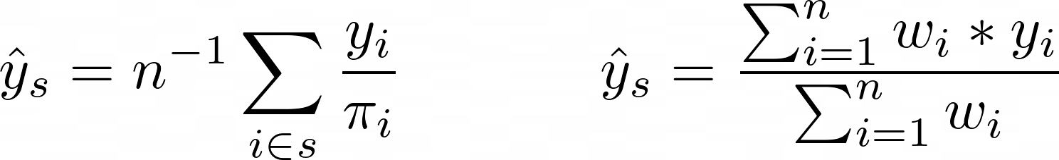
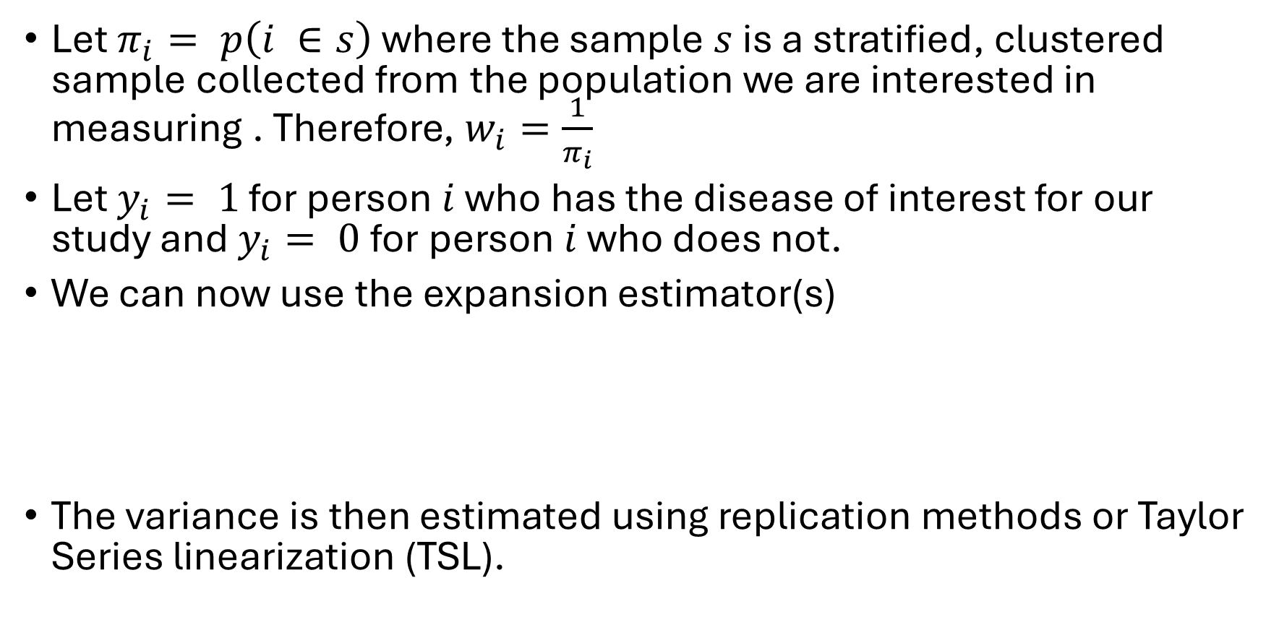
Set up for model: Expansion Estimator
Let $π_{i}= p\left(i ∈s\right)$ where the sample $s$ is a stratified, clustered sample collected from the population we are interested in measuring . Therefore, $w_{i}=\frac{1}{π_{i}}$
Let $y_{i}= 1$ for person $i$ who has the disease of interest for our study and $y_{i}= 0$for person $i$ who does not.
We can now use the expansion estimator(s)
The variance is then estimated using replication methods or Taylor Series linearization (TSL).

Slide 5
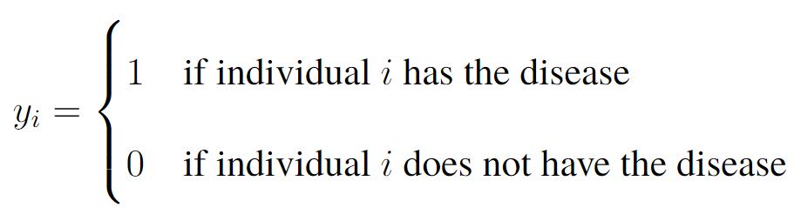
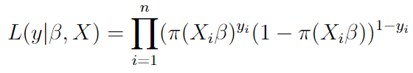

Set up
Individuals $i = 1,…n$.
Our dependent variable is binary.
The likelihood of the data then, given an $n x k$matrix of predictor variables where $k$ is the # of predictors:
Set this equal to zero to solve for $β$
{
}

Slide 6
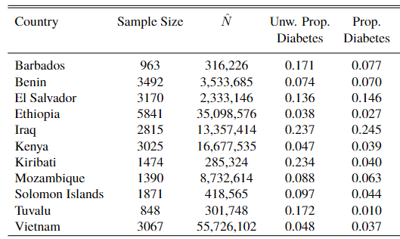
Do the weights have an impact on our estimates?
We can assume that including weights will increase the uncertainty of our estimates.
But what about the proportion of those with disease?
1
2
3
4
5
6
7
8
9
10
11

Slide 7
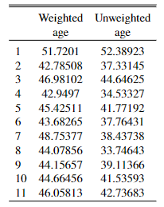
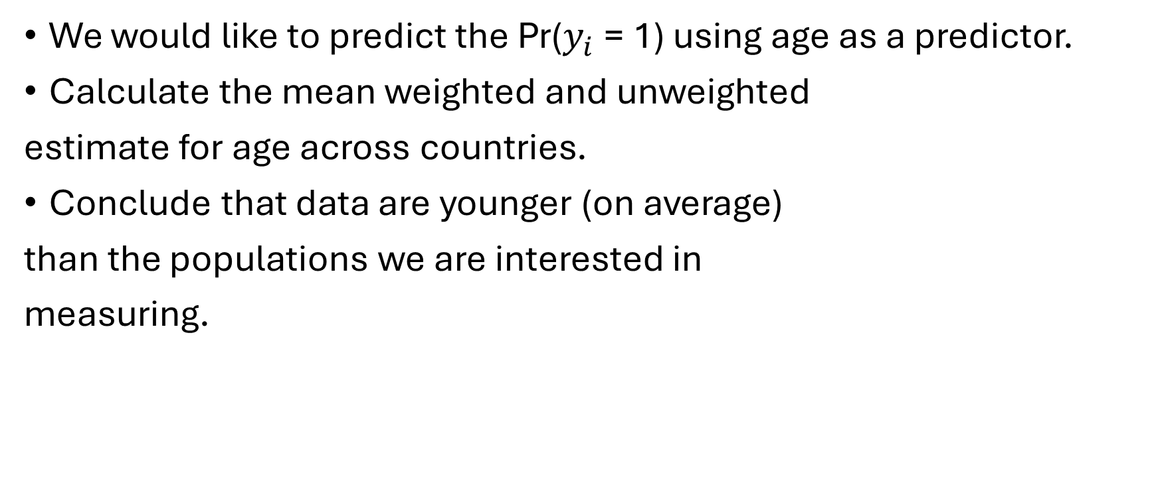
Do the weights have an impact on covariates?
We would like to predict the Pr($y_{i}$ = 1) using age as a predictor.
Calculate the mean weighted and unweighted
estimate for age across countries.
Conclude that data are younger (on average)
than the populations we are interested in
measuring.

Slide 8
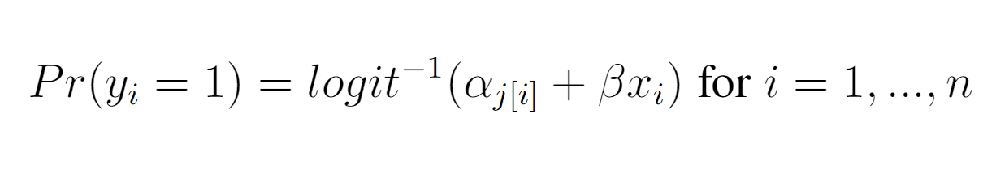
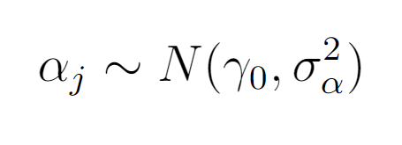
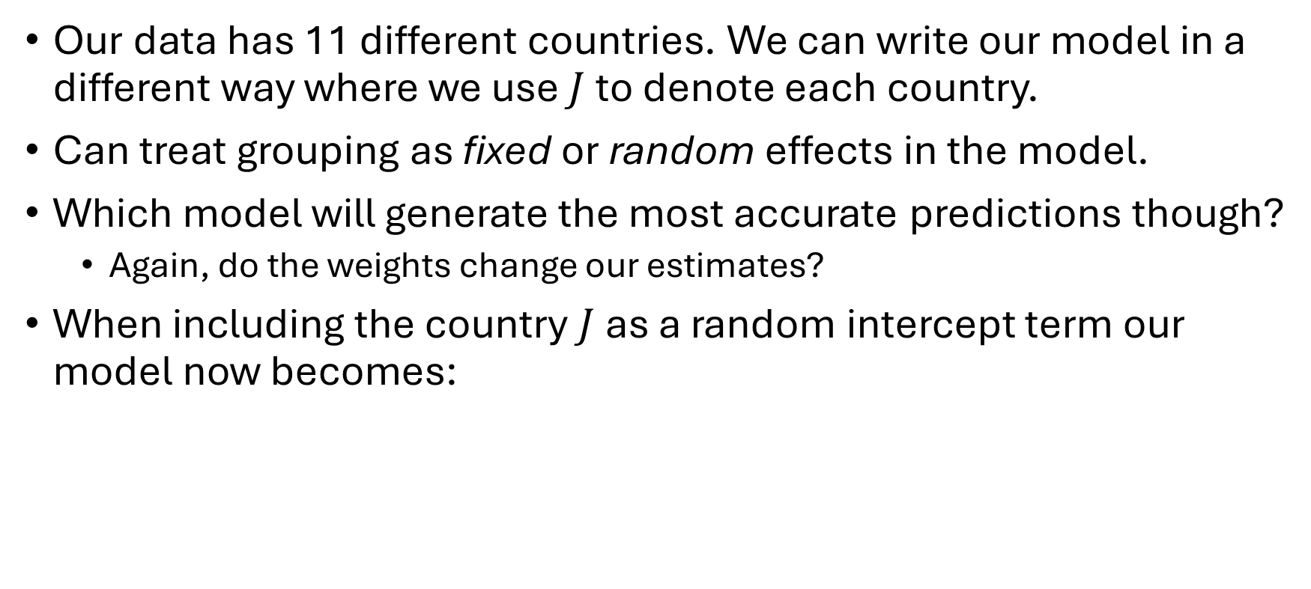
How to best accommodate grouping in data?
Our data has 11 different countries. We can write our model in a different way where we use $J$ to denote each country.
Can treat grouping as fixed or random effects in the model.
Which model will generate the most accurate predictions though?
Again, do the weights change our estimates?
When including the country $J$ as a random intercept term our model now becomes:

Slide 9
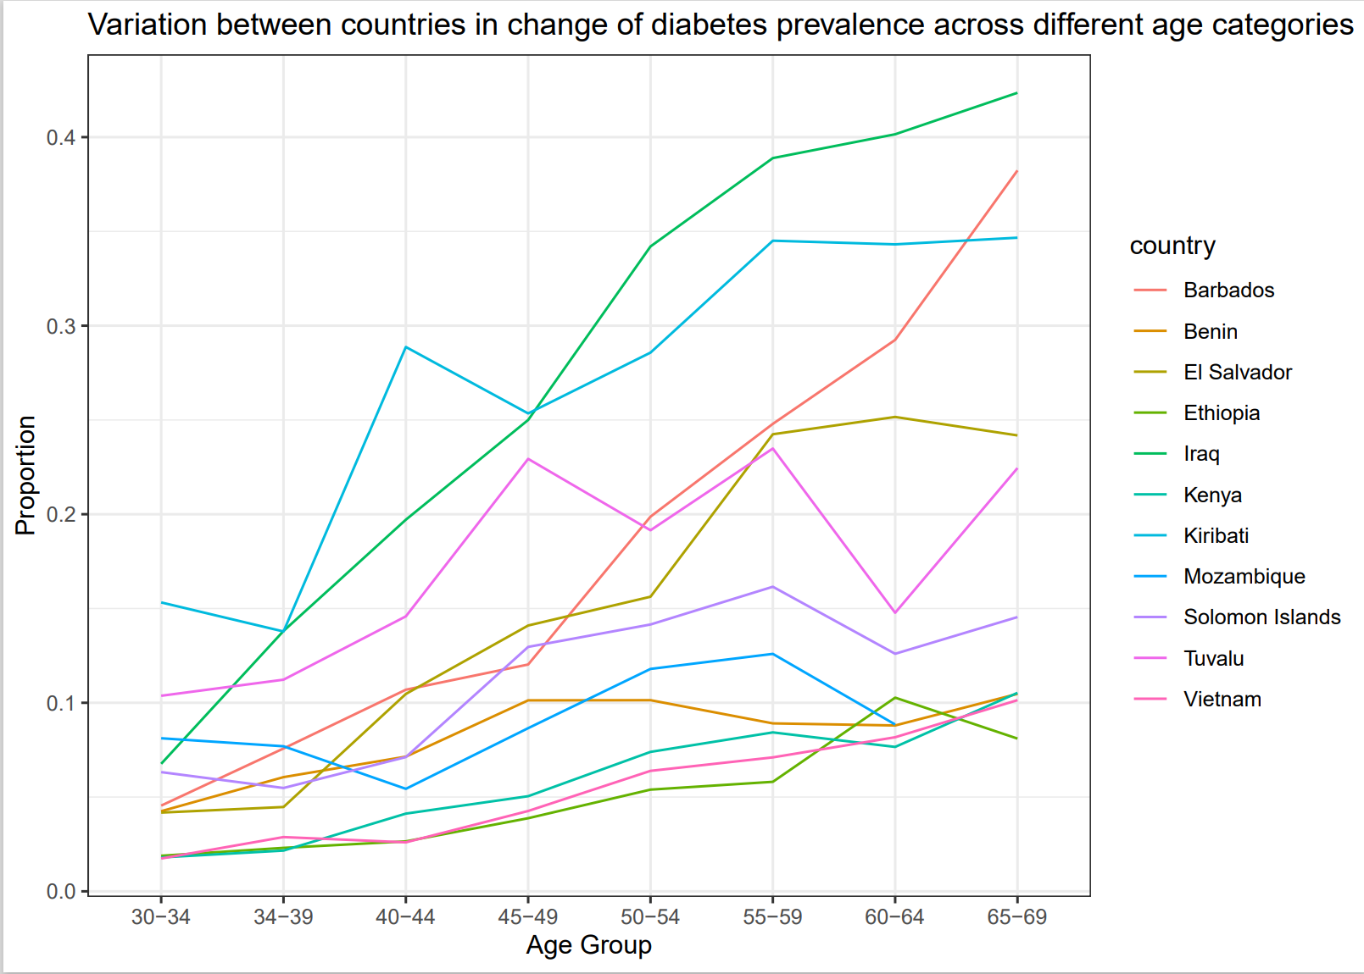
Additional variation between countries
This chart shows that the change in our outcome across age differs between each country
We do not have to restrict our model to only have varying intercepts
Can allow slopes to vary for age!
Variation between countries in change of disease prevalence across different age categories
1
2
3
4
5
6
7
8
9
10
11

Slide 10
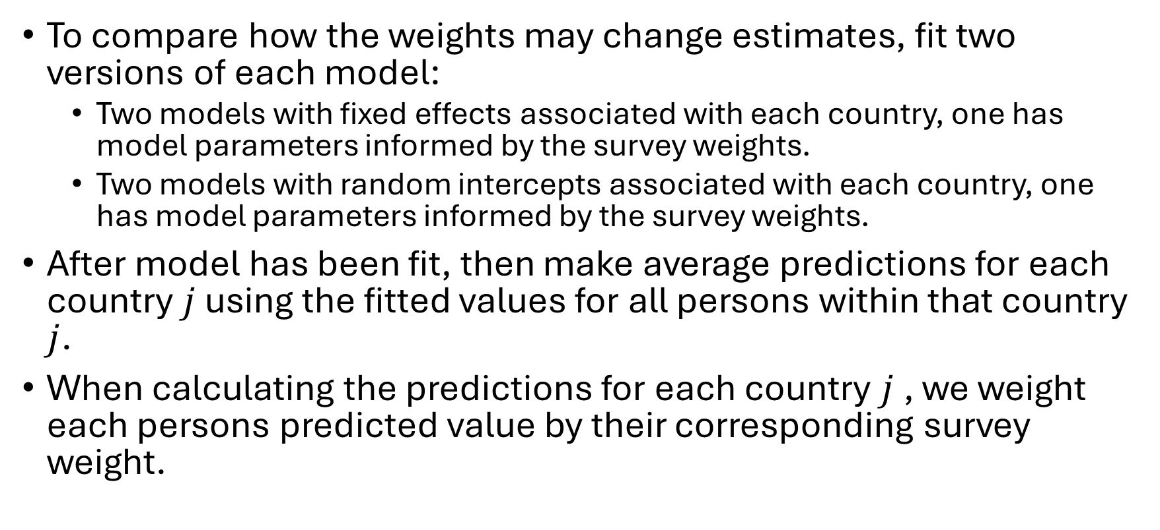
Model fitting & predictions
To compare how the weights may change estimates, fit two versions of each model:
Two models with fixed effects associated with each country, one has model parameters informed by the survey weights.
Two models with random intercepts associated with each country, one has model parameters informed by the survey weights.
After model has been fit, then make average predictions for each country $j$ using the fitted values for all persons within that country $j$.
When calculating the predictions for each country $j$, we weight each persons predicted value by their corresponding survey weight.

Slide 11
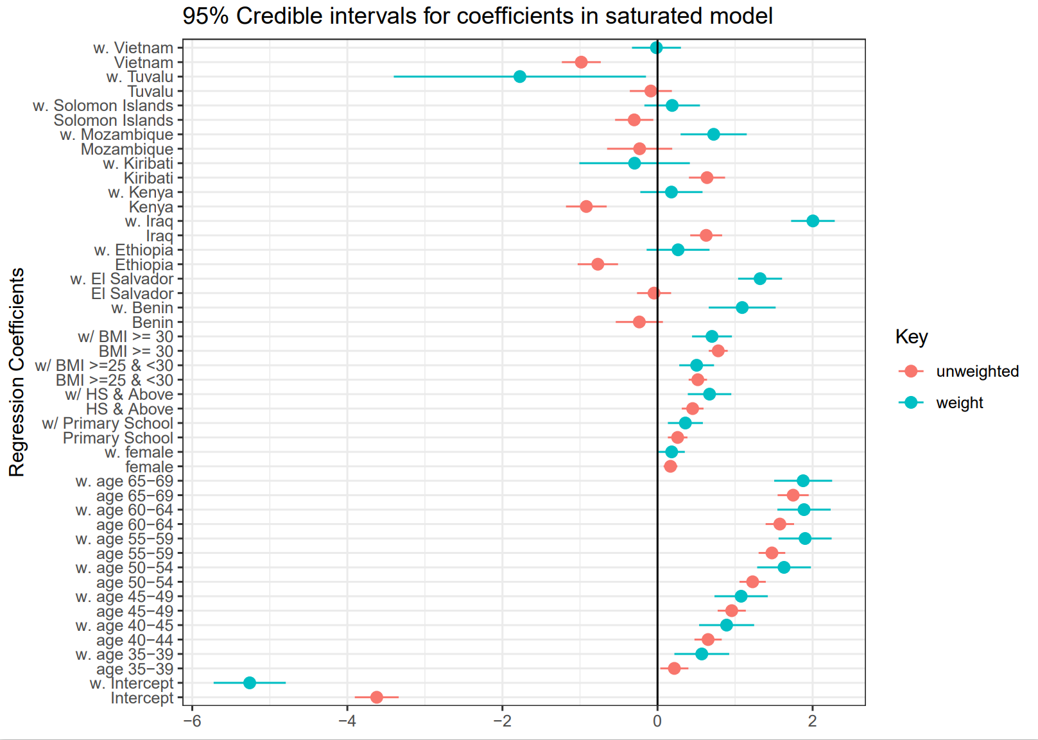
Comparison of model parameters
95% CI for estimated coefficients in model with fixed effects for each country
Model includes age (categorical), gender, BMI and fixed effects for each country as predictors.
Including weights increases the variance.
The coefficients that exhibit the largest shift are those associated with the country fixed effects!
w. 11
11
w. 10
10
w. 9
9
w. 8
8
w. 7
7
w. 6
6
w. 5
5
w. 4
4
w. 3
3
w. 2
2
{
weighted

Slide 12
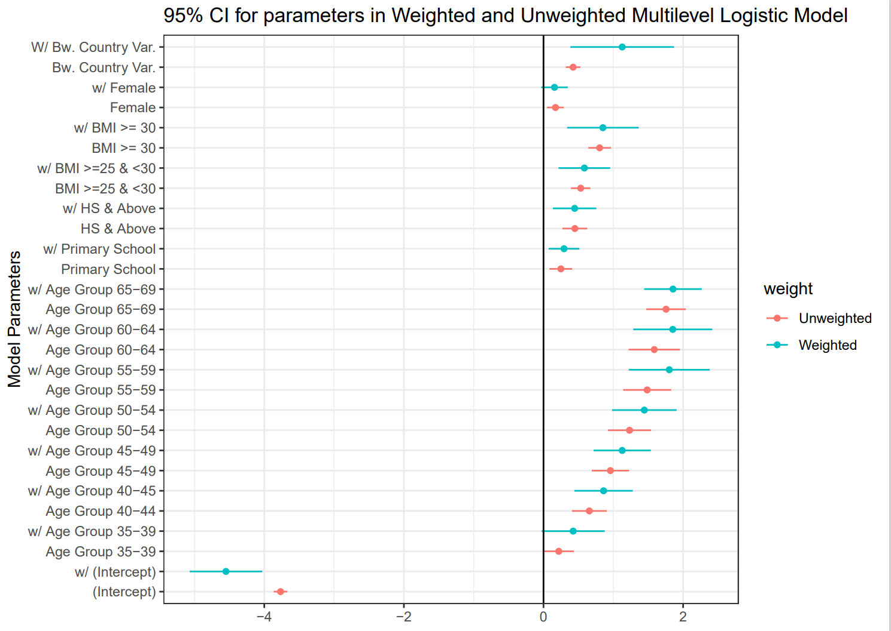
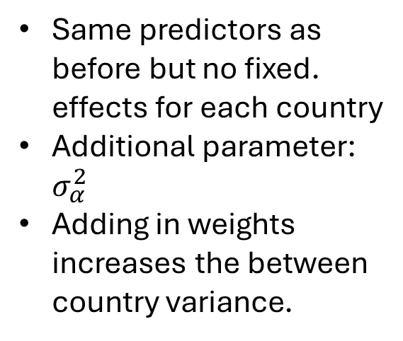
Comparison between multilevel models
Same predictors as before but no fixed. effects for each country
Additional parameter: $σ_{α}^{2}$
Adding in weights increases the between country variance.

Slide 13
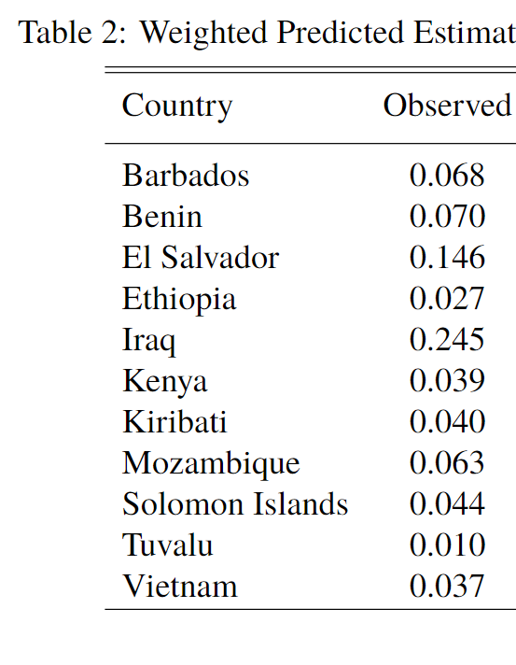
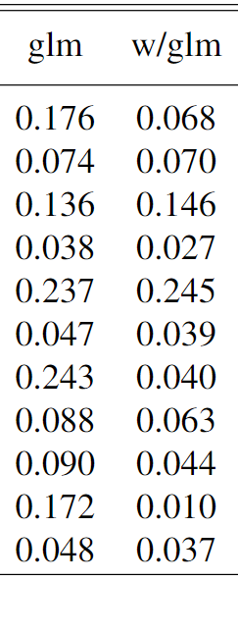
Weighted predictions for fixed effect models
The model informed by the survey weights calculates predictions to be almost the same as the observed average disease prevalence!
Although for some countries there is not a large difference…
For countries 1,7,9 & 10 we do observe a change (all have a finite population size < 500,000)
Weights appear to be more impactful for smaller country estimates
1
2
3
4
5
6
7
8
9
10
11
0.077
0.077

Slide 14
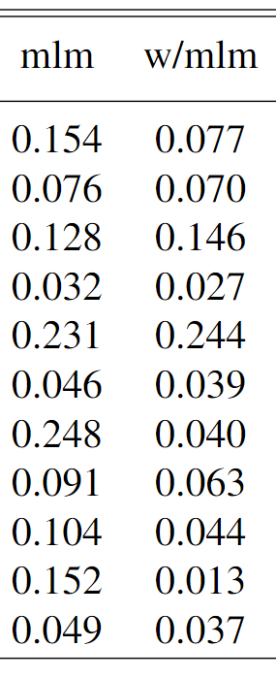
Weighted predictions for mixed effect models
We observe the same change when we apply the weights to the random effect model
Random effects and fixed effects capture the between country difference comparably when the weights are included in fitting the model
1
2
3
4
5
6
7
8
9
10
11
0.077

Slide 15
Summary
What did we learn…?
Important to examine how weights change descriptive statistics associated with dependent and predictor variables included in analysis.
Weighting predictions after a model has been fit without incorporating the weights (pseudo maximum likelihood) may not fully adjust estimates.
This may be especially true if groups that are of predictive interest widely range in total population size
Including fixed effects or random effects for each group results in comparable predictions.
Although this may change when including a larger number of groups.

Slide 16
References
[Binder, 1983] Binder, D. A. (1983). On the variances of asymptotically normal estimators from complex surveys. 51(3):279–292. Publisher: [Wiley, International Statistical Institute (ISI)].
[Danaei et al., 2021] Danaei, G., Finucane, M. M., Lu, Y., Singh, G. M., Cowan, M. J., Paciorek, C. J., Lin, J. K., Farzadfar, F., Khang, Y.-H., Stevens, G. A., Rao, M., Ali, M. K., Riley, L. M., 23
Robinson, C. A., and Ezzati, M. (2021). National, regional, and global trends in fasting plasma glucose and diabetes prevalence since 1980: systematic analysis of health examination surveys and epidemiological studies with 370 country-years and 2·7 million participants. 378(9785):31– 40.
[Finucane et al., 2014] Finucane, M. M., Paciorek, C. J., Danaei, G., and Ezzati, M. (2014). Bayesian estimation of population-level trends in measures of health status. 29(1):18–25. Pub- lisher: Institute of Mathematical Statistics.
[Heeringa et al., 2017] Heeringa, S. G., West, B., and Berglund, P. A. (2017). Foundations and techniques for design-based estimation and inference. In Applied Survey Data Analysis, pages 55–95. Chapman and Hall/CRC, 2 edition.
[Hornby et al., ] Hornby, R., Williams, M. R., Savitsky, T. D., and Elkasabi, M. csSampling: An r package for bayesian models for complex survey data.
[Kish, 1965] Kish, L. (1965). Survey sampling. Survey sampling. Wiley. [Pfeffermann et al., 1998] Pfeffermann, D., Skinner, C. J., Holmes, D. J., Goldstein, H., and Ras- bash, J. (1998). Weighting for unequal selection probabilities in multilevel models. 60(1):23–40. eprint: https://onlinelibrary.wiley.com/doi/pdf/10.1111/1467-9868.00106.
[Rabe-Hesketh and Skrondal, 2006] Rabe-Hesketh, S. and Skrondal, A. (2006). Multilevel modelling of complex survey data. 169(4):805–827. eprint: https://onlinelibrary.wiley.com/doi/pdf/10.1111/j.1467-985X.2006.00426.x.
[Skinner, 1989] Skinner, C. J. (1989). Domain means, regression and multi-variate analysis. In Skinner, C. J., Holt, D., and Smith, T. M. F., editors, Analysis of Complex Surveys, pages 59–88. Wiley.

Slide 17
For those further interested:
Applied Survey Data Analysis (Heeringa, West & Berglund 2017): https://websites.umich.edu/~surveymethod/asda/
Access publicly available STEPS data: https://extranet.who.int/ncdsmicrodata/index.php/home
Almost 900 data sets
Full HPACC data set available at Harvard Dataverse: https://dataverse.harvard.edu/dataverse/hpacc
Available by written proposal
Contact: raxworth@umich.edu
Thank you!

Slide 18
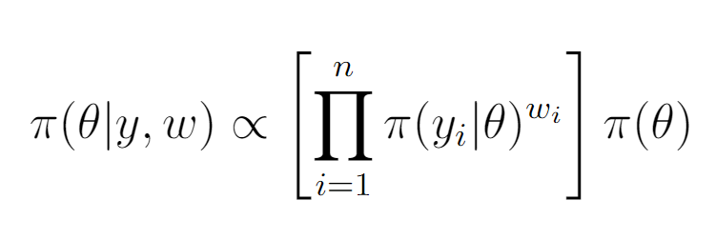
Is it possible to estimate the weighted posterior?
The short answer is, yes!
The weighted pseudo posterior (Hornby et al. 2023) can be written as:
The `brms` package in R allows users to specify their model with weights
Difficulty is with calculating the design adjusted variance
The `csSampling` package in R can calculate the design adjusted variance estimate for clustering and stratification (still in early stages of development)

Slide 19
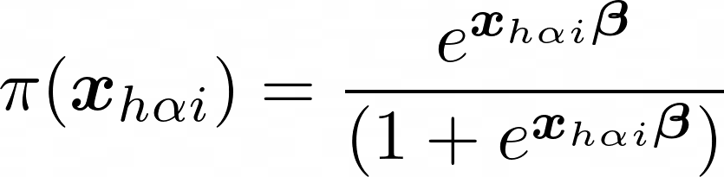
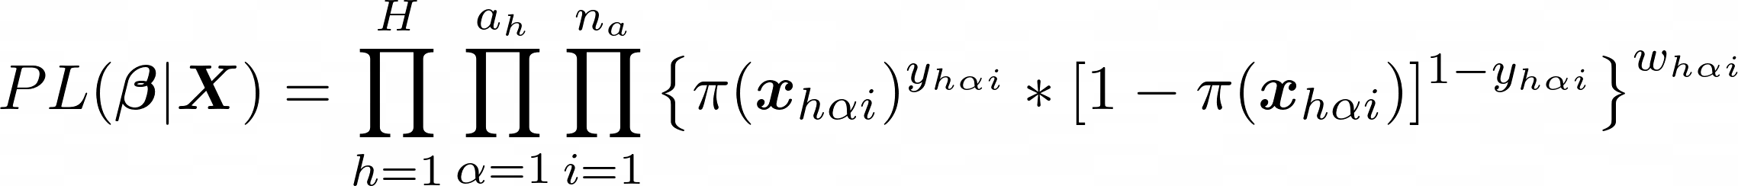
Weighted Pseudo Log-Likelihood Estimation (PMLE)
For a binary variable we first define our link function. For logistic regression we use the inverse link function:
We then define the weighted
PMLE function as:
We then maximize this function using the Newton-Raphson or other optimization algorithm

